Slide 1
Partition Method
A Block View of Gaussian Elimination

Slide 2
Partition Method
It is a block alternative to the popular Gaussian Elimination method of solving the system of linear equations.
Just like how individual entries are eliminated in Gaussian elimination, here instead, block matrices are eliminated.
The coefficient matrix is reduced into smaller sub matrices and finally back substitution is used to find the values of unknowns.

Slide 3
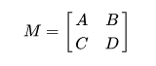
Prerequisites : Schur complement
Let M be a block matrix where, A is p x p submatrix, B is p x q submatrix, C is q x p submatrix and D is q x q submatrix.
Let D be an invertible matrix. Then the Schur complement of D with respect to M is defined as follows.
M/D := A - BD⁻¹C
We will see how Schur complement naturally occurs when eliminating block matrices in partition method.

Slide 4
Partition Method : Phases
There are 2 phase of partition method.
1. Matrix Reduction
2. Back Substitution

Slide 5
Partition Method : Matrix Reduction Phase
The coefficient matrix is divided into 4 submatrices.
First submatrix consist of only one element present at the first row and first column.
Second submatrix consists of all the remaining elements of first row.
Third submatrix consists of all the remaining elements of first column.
Fourth submatrix consists of all the elements below to the first row and right to the first column.

Slide 6
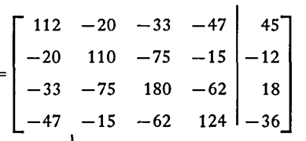
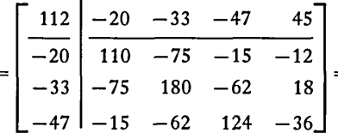
Partition Method : Matrix Reduction Phase
Example.
Let’s say we have below augmented matrix. Then its partition is done as follows.
partition

Slide 7
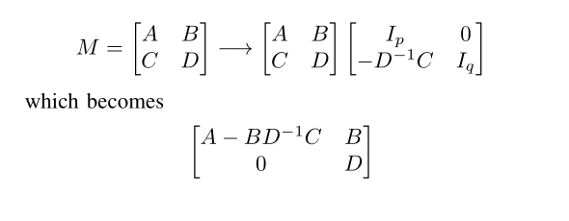
Partition Method : Matrix Reduction Phase
We need to eliminate C to make matrix M upper triangular.
We will multiply the matrix M in following way to do that.
Notice that the now in place of A, we have Schur complement of D.

Slide 8
Partition Method : Matrix Reduction Phase
We then work with only the fourth submatrix from the previous operation.
Notice that now, the size of augmented matrix becomes (n - 1) x (n - 1).
Now, we again do the partition into 4 submatrix in a similar manner as the previous one.
This process is repeated till only one row remains at which point matrix reduction process is terminated.

Slide 9
Partition Method : Back Substitution
Similar to how, we use back substitution in Gaussian elimination, we use this process to get the values of all unknowns.
Hence, the last unknown, x_{n} is obtained first and to get the value of any other unknown x_{i}, value of all unknowns x_{j} such that j > i are used.

Slide 10
Partition Method : Worked out example
Example.
Let’s say we have below augmented matrix. Then its partition is done as follows.
partition

Slide 11
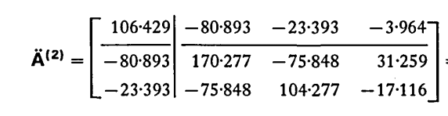
Partition Method : Worked out example
Iteration : 1
reduction

Slide 12
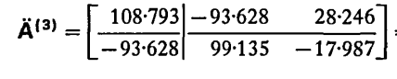
Partition Method : Worked out example
Iteration : 2
reduction

Slide 13
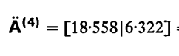
Partition Method : Worked out example
Iteration : 3
Only one row is remained, so stop the process.
reduction

Slide 14
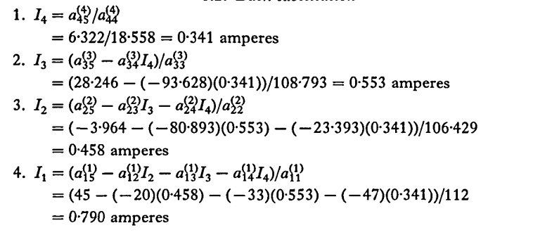
Partition Method : Worked out example
Use back substitution to find the values.

Slide 15

Solving problem with code

Slide 16
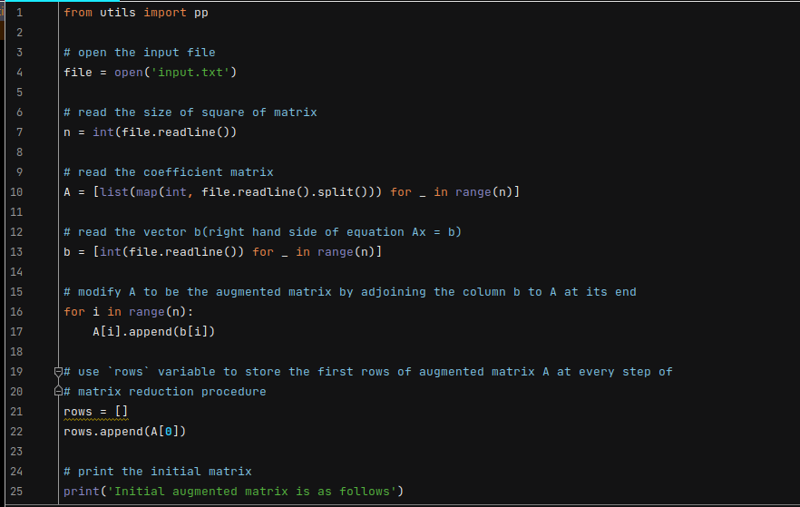

Slide 17
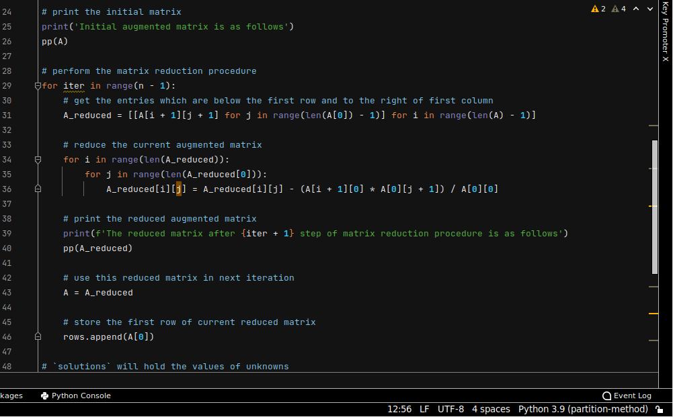

Slide 18
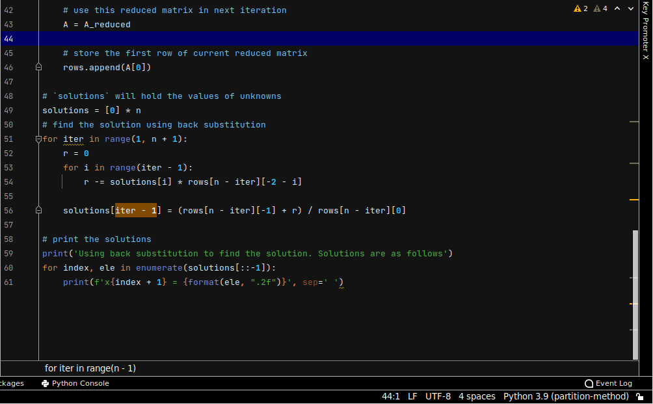

Slide 19
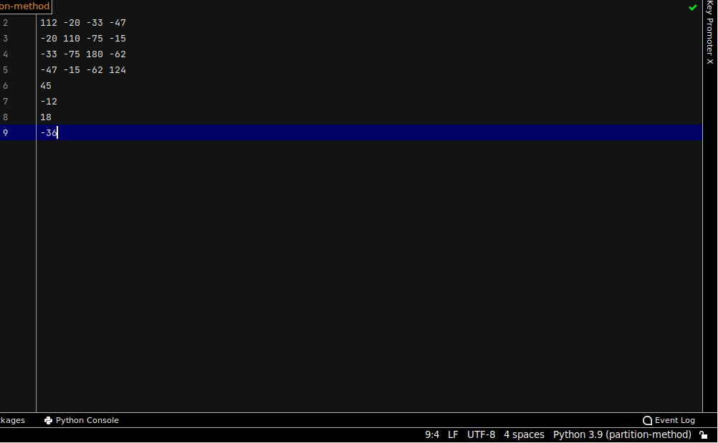

Slide 20
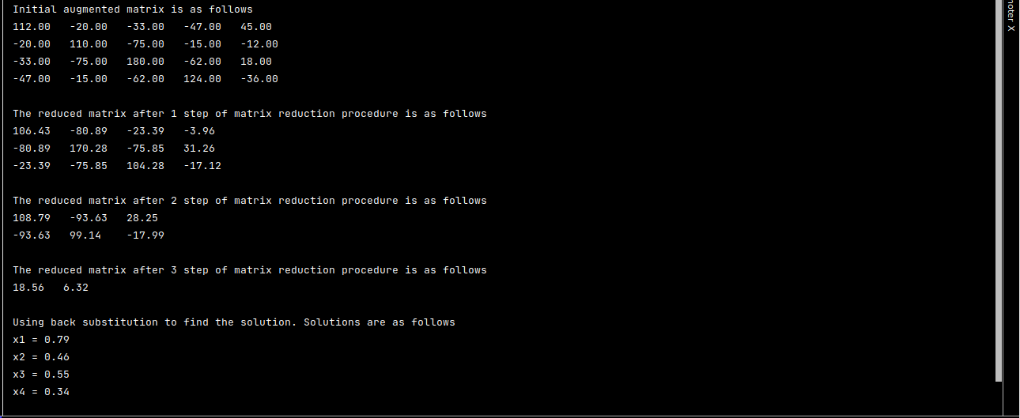

Slide 21
Time Complexity

Slide 22
In Both Gaussian elimination and Matrix reduction, the same number of Arithmetic operations are performed to transform an augmented matrix into a reduced matrix.
As Partition method consists of two steps matrix reduction followed by back substitution, and Gaussian elimination also uses back substitution they are algebraically equivalent.
Both procedures perform the same arithmetic operations at every step and both have (n-1) steps.

Slide 23
In the first iteration of Matrix Reduction we have to perform (n-1)*(n) multiplications and subtractions. In the second iteration (n-2)*(n-1) and so on. After n-1 steps we have a total of n(n²-1)/3 multiplications and subtractions.
In back substitution, n(n-1)/2 multiplications and subtractions are performed.
So, totally n(n - 1)(2n + 5)/6 multiplications and subtractions.
Therefore, the number of operations is of the order of (n³)/3.

Slide 24
Space Complexity

Slide 25
After the matrix reduction procedure ends, we need to use back substitution to find the unknowns.
For that, the equations of back substitution should be stored.
The equation for first unknown involves all coefficients of first row, i.e., n + 1 entries.
The equation for second unknown involves all coefficients of second row, i.e., n entries and so on.
Hence, the order of space needed for storing coefficients of back substitution equations is O(n²)

Slide 26
Applications

Slide 27
APPLICATION OF THE PARTITIONING METHOD
Presented by Dablu Chauhan
1)image restoration
Partitioning method are use in image restoration.in restoration of image blurred image has been a fundamental problem in digital imaging for a long time.the field of image restoration has been of great interest in the scientific field.image restoration is done by partitioning method and its application in several scientific area including medical imaging and diagnosis,military surveillance,satellite imageing etc.

Slide 28



(a) original image b) blurred noisy image (c)Moore–Penrose restored image
2) Robotics:-
in control robotics,non-collocated partial linearization is applied to underactuated mechanical system through inertia-decoupling regulators which employ a pseudoinverse as part of a modified input control law.

Slide 29
3)Adaptive processing in radar:-
Partition matrix is widely employed in several scientific technology application area .Toeplitz based covariance matrices are use to model structure properties for space-time multivariate adaptive processing in radar.
4)wireless communication system:-
In the wireless communication system, there are three component in wireless communication system which is formaly known as transmitter,channel and receiever.transmiter transmit the signal and receiver received the signal .and signal are pass through channel.channel are represented in the form of matrix and that matrix are solved by using partitioning method in very easy way.

Slide 30
Presentation Contributors
Chandrakishor Singh: slide 1-19, 23-24, 29
Dablu Chauhan: slide 25-28
Madhu Donipati: 20-22
References
1. Theodore J. Sheskin (1996) A partitioning algorithm for solving systems of linear equations, International Journal of Mathematical Education in Science and Technology, 27:5, 641-648,DOI:10.1080/0020739960270502
2. Wikimedia Foundation. (2021, September 2). Schur com-
plement. Wikipedia. Retrieved October 13, 2021, from
https://en.wikipedia.org/wiki/Schur complement.
3. Banham, M.R. and Katsaggelos, A.K. (1997). Digital image restoration, IEEE Signal Processing Magazine 14(2): 24–41.
4. P. Cervantes, L.F. González, F.J. Ortiz and A.D. García (July 11th 2012). Partition-Matrix Theory Applied to the Computation of Generalized-Inverses for MIMO Systems in Rayleigh Fading Channels, Linear Algebra - Theorems and Applications, Hassan Abid Yasser, IntechOpen, DOI: 10.5772/48198. Available from: https://www.intechopen.com/chapters/37785

